Slide 1
Academic success plan
Fowler Grade School
2022-2023

Slide 2
standards
Professional Development
Lesson Planning Expectations
Standards Based Report Cards

Slide 3
Professional Development
August Inservice
Refresher on state standards and depth of knowledge.
Refresher on how to conduct a data sort to match reading interventions to student needs.
Refresher on dyslexia screening.
Additional time and support with the FastBridge assessment and intervention tool.

Slide 4
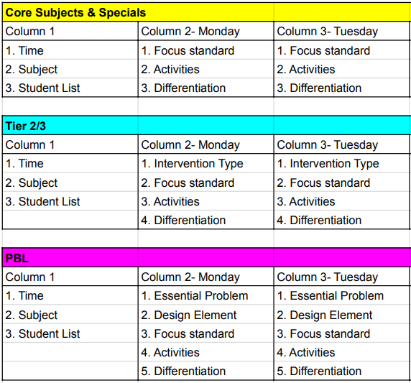
Lesson Planning
Lesson plans will serve as evidence that we are aligning classroom activities with state standards.
Plans will include a focus standard for each lesson.
Lesson planning template will be provided to teachers during August inservice with time to set up their plan books with support.

Slide 5
Standards Based Report Cards

Slide 6
assessment
State Assessments
Interim Assessments
FastBridge Diagnostic Assessments

Slide 7
State Assessments
Annual- in the Spring
Provides broad information about individual strengths and weaknesses.
Shows us how we compare to the state averages.
Helpful for looking at long-term progress.
The standards that are assessed and the cut scores are not the same grade to grade, so this is more difficult to determine growth.

Slide 8
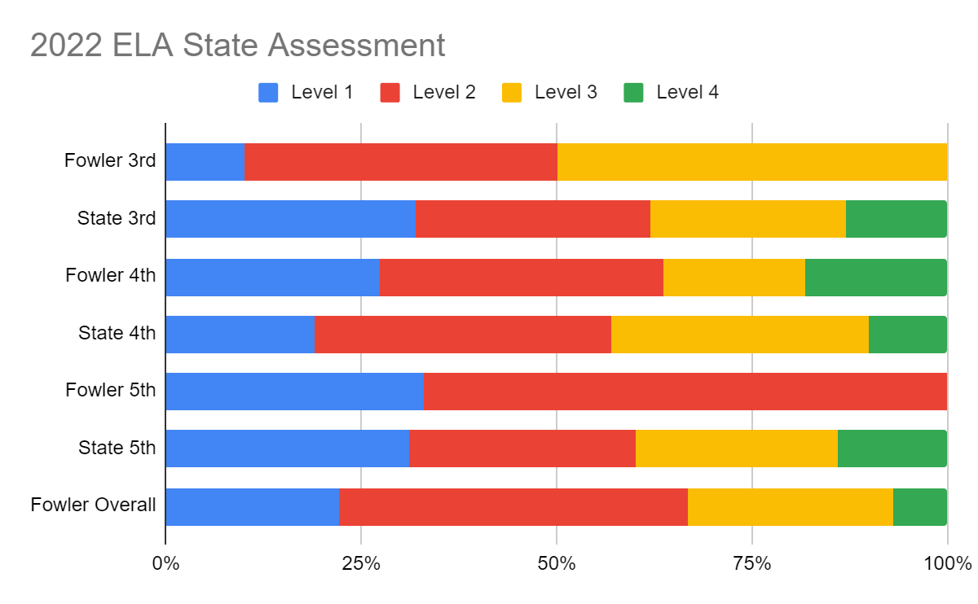
State Assessment Baseline- ELA
Fowler Overall
Level 1 | 22%
Level 2 | 44%
Level 3 | 26%
Level 4 | 7%

Slide 9
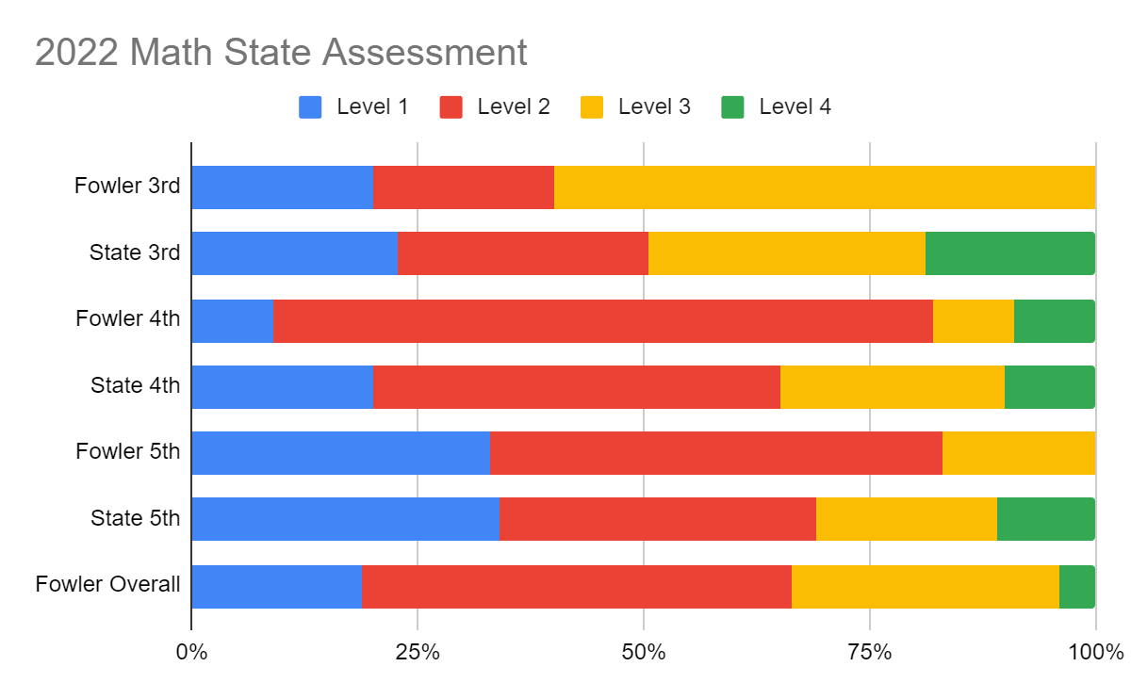
State Assessment Baseline- Math
Fowler Overall
Level 1 | 19%
Level 2 | 48%
Level 3 | 30%
Level 4 | 4%

Slide 10
Interim Assessments
3 times per year
Not required by the state.
Same program as the state assessment.
Provides teachers with specific standards that students have or have not mastered.
Helps with planning instruction and intervention.
Still difficult to determine growth.

Slide 11
FastBridge Diagnostic Assessments
Given 3 times per year- combination of computer and face-to-face administration.
Provides a standard score to compare growth each period.
Provides teachers with specific information about skills students have and have not mastered.
Prescribes the next steps for individual instruction and sometimes provides specific lessons or activities to use to provide that instruction.
Students are flagged as Tier 2 or Tier 3 by the diagnostic.
Tier 2 & Tier 3 students are “sorted” into 4 quadrants based on their scores.

Slide 12
Tiered System of Supports

Slide 13
FastBridge Quadrant Sort
Quadrant 1 Accurate and Fluent K-2 = 7 students 3-6 = 9 students Plan of Action: Work on monitoring for meaning Teach important words directly and word-learning strategies Monitoring: Class-wide assessments Exit criteria: Proficient on district-wide assessments and demonstrates grade level knowledge of vocabulary and comprehension. | Quadrant 2 Accurate and Slow K-2 = 2 students 3-6 = 2 students Plan of Action: Repeated readings May need to do automaticity work at the word or phrase level in addition to passages Monitoring: Oral reading fluency at least once a week Exit Criteria: Oral reading fluency benchmark range for grade
Quadrant 3 Inaccurate and Slow K-2 = 9 students 3-6 = 4 students Plan of Action: Work on missing decoding skills Work on missing sight words skills Monitoring: Oral reading fluency at least once a week - expect a change in accuracy before fluency. Exit Criteria: Oral reading fluency score shows movement into Quadrant 1 or 2 | Quadrant 4 Inaccurate and Fluent K-2 = 0 students 3-6 = 3 students Plan of Action: Table tap when student makes an error. Teach student to adjust rate of reading to type of text and purpose for reading Monitoring: Oral reading fluency at least once a week - looking for a change in accuracy. Exit Criteria: Oral reading accuracy score shows movement into range for Quadrant 1

Slide 14
Progress monitoring
FastBridge Progress Monitoring
Other Assessment Measures

Slide 15
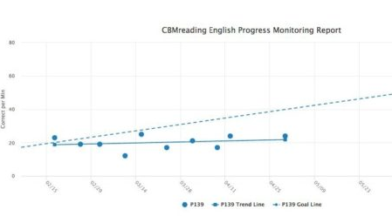
FastBridge Progress Monitoring
Tier 1 students- 3 times/year
Tier 2 students- biweekly
Tier 3 students- weekly
Data points are graphed to compare the student’s growth to their aim line.
Helps determine if the intervention is working.

Slide 16
Other Assessments & Progress Monitoring Tools
Quick Phonics Screener
Breaks down phonics into isolated skills, such as short vowel sounds
Can assess one skill at a time as you work on it
Phonological Awareness Skills Test
Breaks down phonemic awareness into isolated skills, such as beginning sounds or rhyming words
Lexia
Uses an initial diagnostic to place students at their instructional level for overall reading skills
Prescribes lessons to be taught face-to-face when a child is struggling to pass a concept
iReady
Similar to Lexia, but for math

Slide 17
Data dives & collaboration

Slide 18
Collaboration Meetings
Grade Level Teams
PK/K & 1/2 weekly
3/4 & 5/6 weekly
Reading Lab team- daily collaboration and weekly team planning
Whole Staff
Monthly meeting
Review new data and the overall path of a student’s intervention
Give direction to Reading Lab team
Conduct data sorts together

Slide 19
Data Dives
Wilson Phonics
Grade | Student | Lexia Level | FastBridge Recommendation
K | Student A | 3 | 0.2 PA & Phonics
K | Student B | 4 | 0.2 PA & Phonics
K | Student C | 4 | 0.2 PA & Phonics
K | Student D | 2 | 0.2 PA & Phonics
1 | Student E | 3 | 0.2 PA & Phonics
K | Student F | 5
K | Student G | 5
Read Naturally
Grade | Student | Lexia Level | FastBridge Recommendation
3 | Student H | 10 | 3.2 PH & FL
4 | Student I | 13 | 1.2 PH & FL
3 | Student J | 10 | 1.2 PH & FL
2 | Student K | 9 | 2.2 PH & FL

Slide 20
Reading lab
Daily Learning Expeditions
Weekly Student Goals
Wildly Important Goal

Slide 21
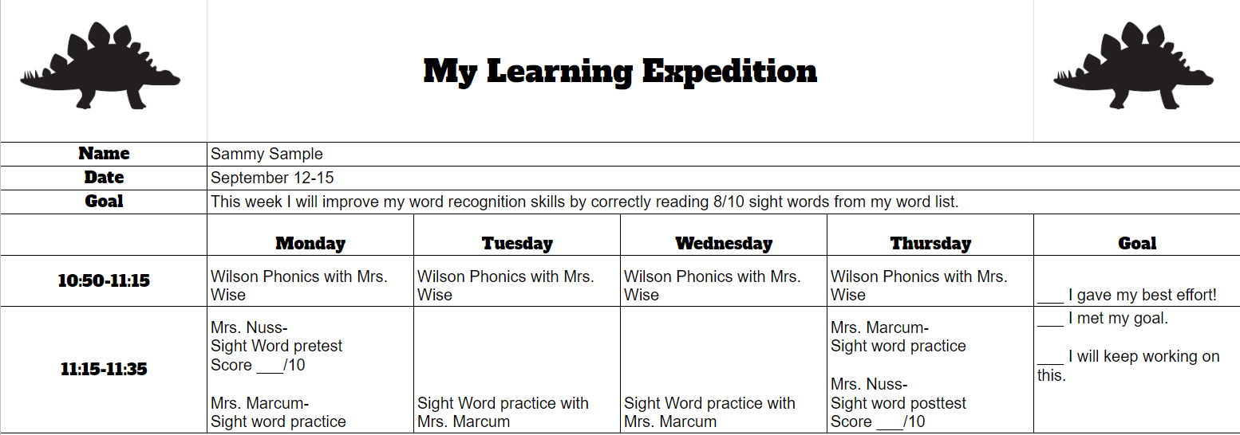
Learning expeditions

Slide 22
Learning expeditions

Slide 24
math
Team Teachers will assist students with daily practice assignments and then oversee their progress on individualized lessons within iReady.
iReady continuously progress monitors all students based on daily activity.
Teachers will plan one-on-one support based on student progress within iReady and FastBridge.
Many math manipulatives are available.

Slide 25
celebrations
Daily- Garden of Growth- Add a leaf to the tree by the office for each iReady lesson that you pass.
Weekly- Add a dinosaur puzzle piece to your dinosaur in the Reading Lab for completing your Learning Expedition.
Quarterly- School-wide celebrations planned by the Leadership Council for meeting our Wildly Important Goal.

Slide 26
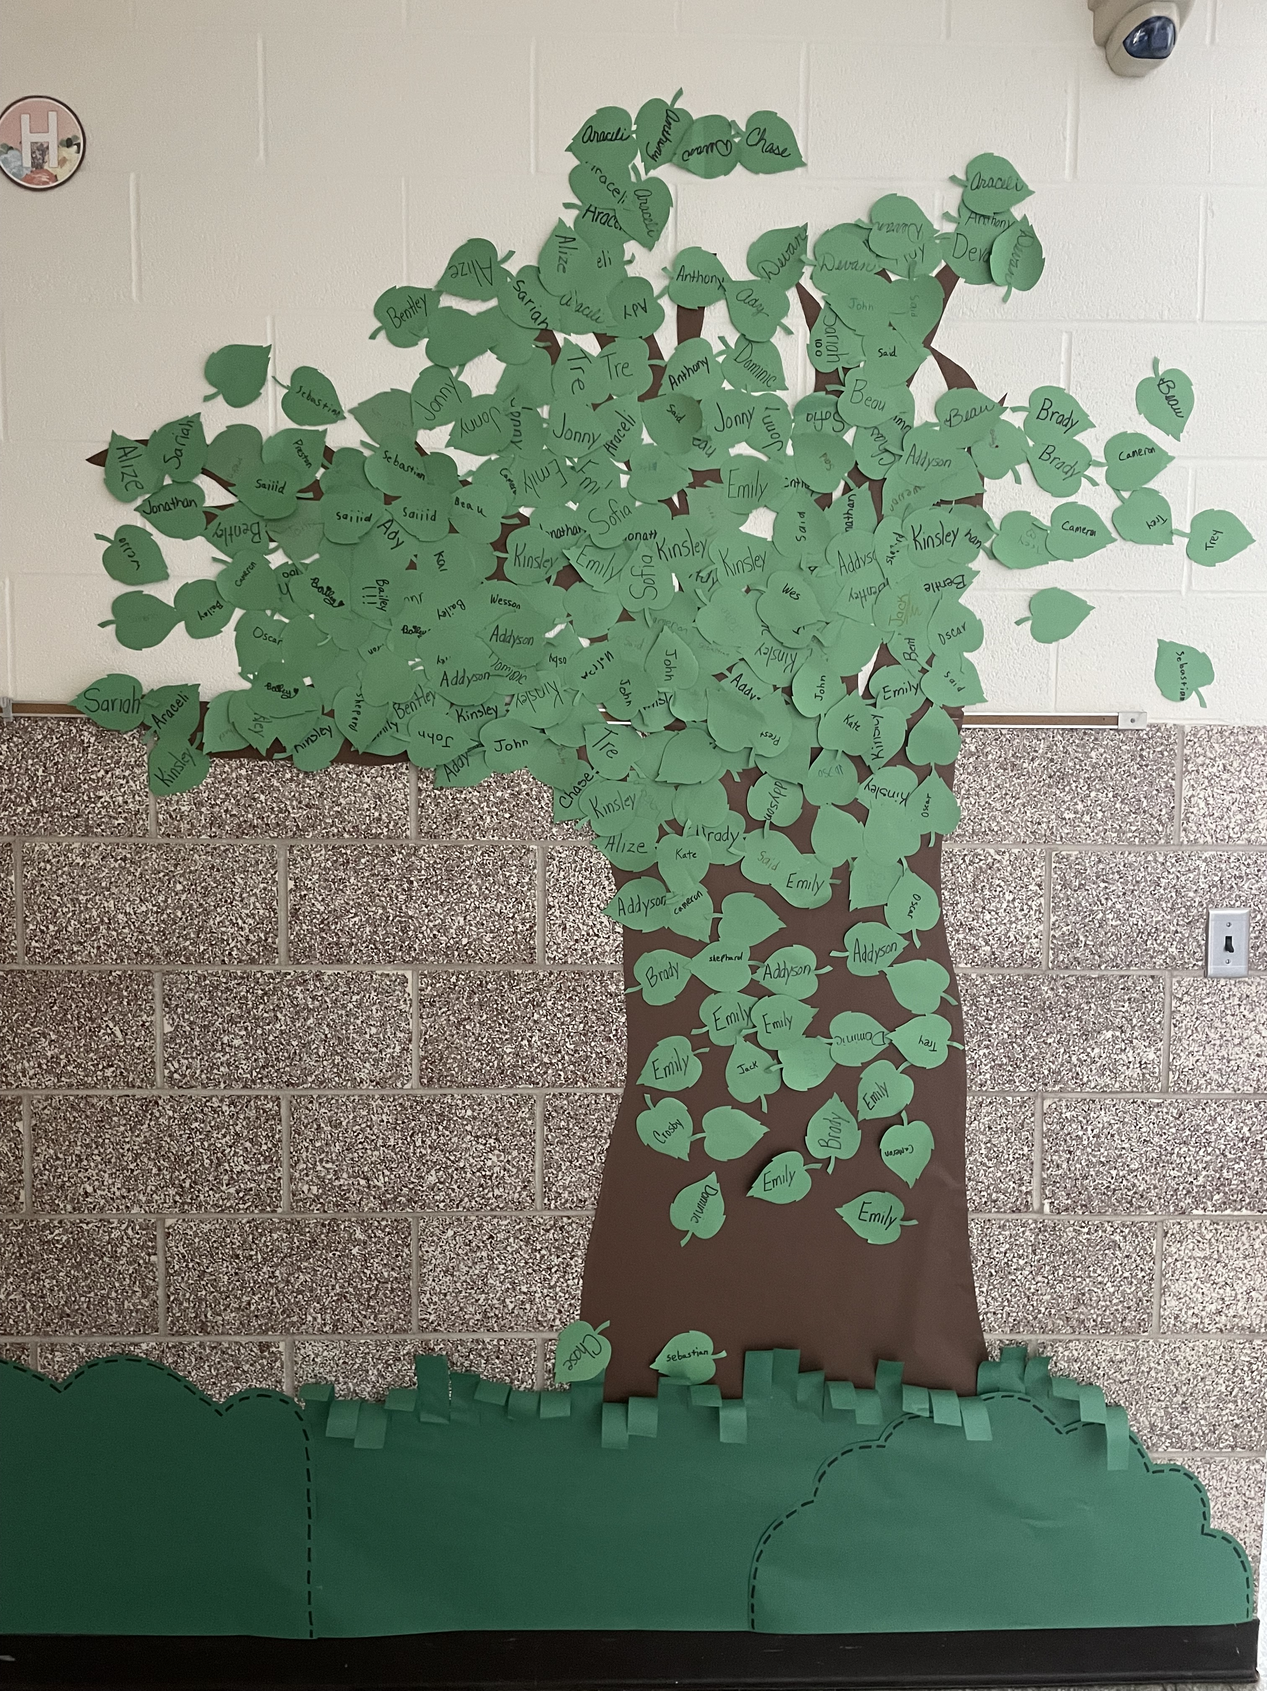
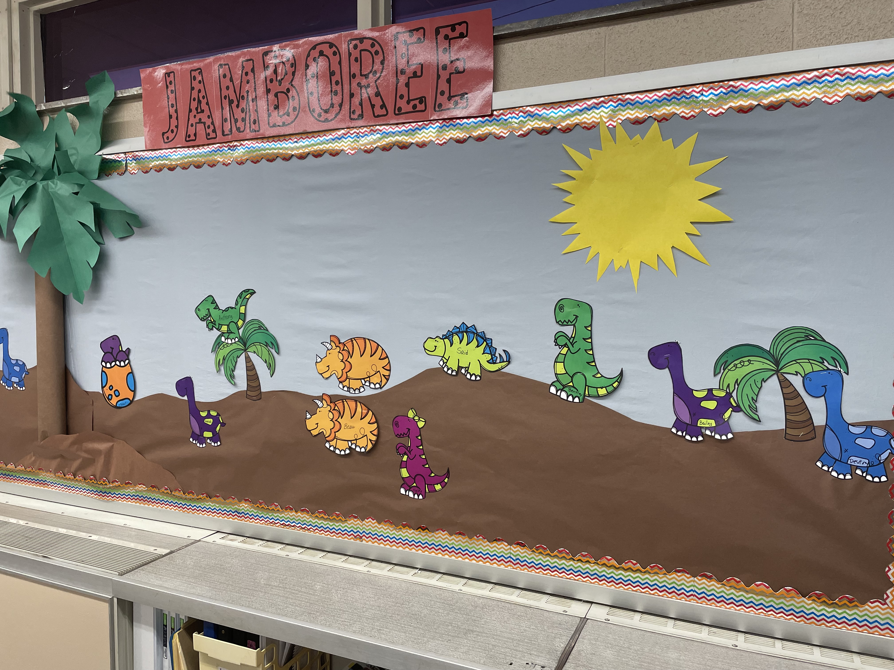
celebrations

